Slide 1



From Dev to Ops: Delivering an API to Production with Splunk

Slide 2


Speakers
Services provided:
IT Infrastructure
Cloud
Managed Service Solutions
Serving 900 Health Plans, 90 million members, 750,000 providers and 5,000 financial institutions
Multi-TB SQL Server database
Over 15 Billion Rows

Slide 3

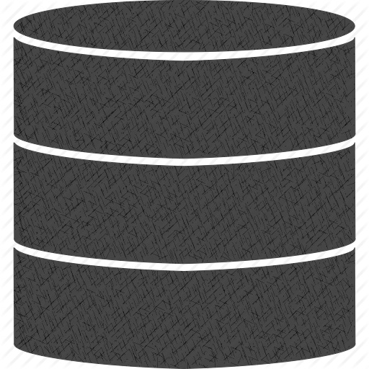
Aspects of Delivering Internet Grade Services
Design
Code
Deploy
Operate

Slide 4
Design with Production in Mind
Scalability & Fault Tolerance
REST-based architecture
Stateless
Load-Balancing
Versioning
How will you troubleshoot in production?
Only production acts like production
You need operational visibility
Pressure to increase velocity and delivery business value
Limited insights into behavior and performance from application logs
Building comprehensive management tools take time

Slide 5

Design with Production in Mind
Because
s Happen

Slide 6
Coding the service
REST-based API
Dependency Injection
ORM
Database
Logging Framework

Slide 7
Logging Best Practices
Write log data to local file
Institute a log rotation policy
Begin each event with a timestamp
Generate a unique identifier that is assigned to related events
Use key-value pairs to describe the properties of events
Standardize field names across the application
Avoid excessively long events
Avoid spamming the log

Slide 8

Coding the Service
Demo

Slide 9

Deployment Considerations
Internet Connectivity, Power
Management, Cooling, Physical Security
Data Center or Cloud
Network, Load Balancing, Compute, Storage, Security
Data Center or IT or Cloud

Slide 10
Operating Your API in Production

Slide 11
One way to deal with errors…
Q: how many programmers does it take to change a light bulb?
A: none, they just make darkness standard and tell everyone "this behavior is by design"

Slide 12

Or, you can design for production:
You have a live system, tons of log data, and you need:
Monitoring & Trending
Alerting
Event Correlation
Troubleshooting across multiple systems
Billing

Slide 13
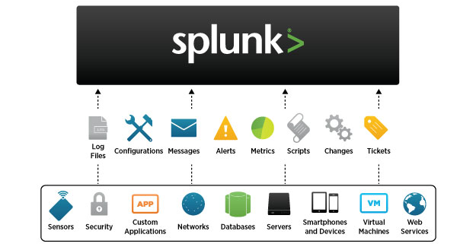
Splunk to the Rescue

Slide 14
Splunk to the Rescue
Looking at logs can be like this:
Two threads walk into a bar. The barkeeper looks up and yells, "hey, I want don't any conditions race like time last!"

Slide 15
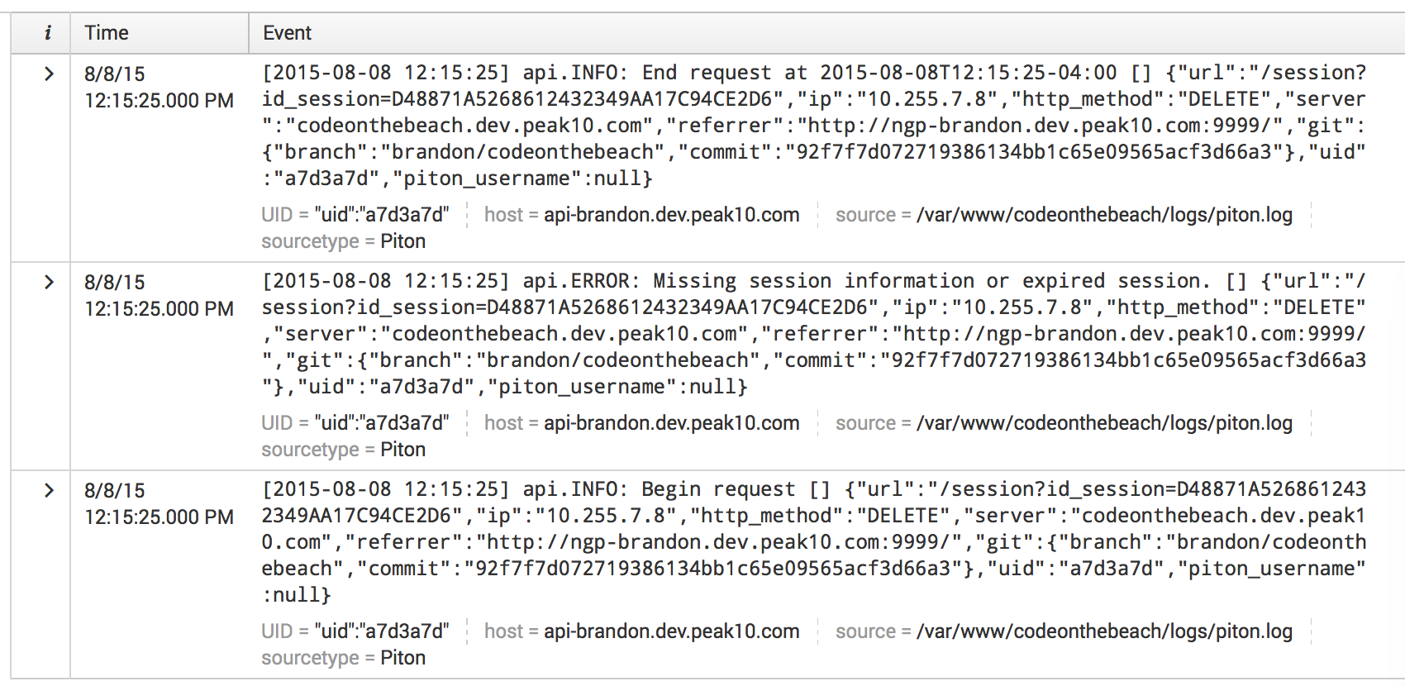
Splunk to the Rescue
But Splunk makes it easy to find & correlate information in your logs:

Slide 16
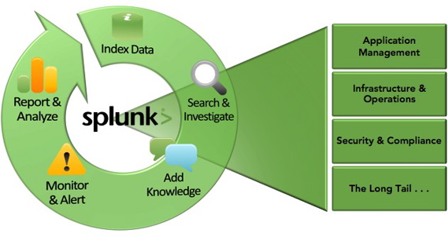
Splunk to the Rescue
Splunk brings value to your machine data making it accessible to the enterprise.
Application Management
Infrastructure & Operations
Security & Compliance
Analysis & Reporting

Slide 17
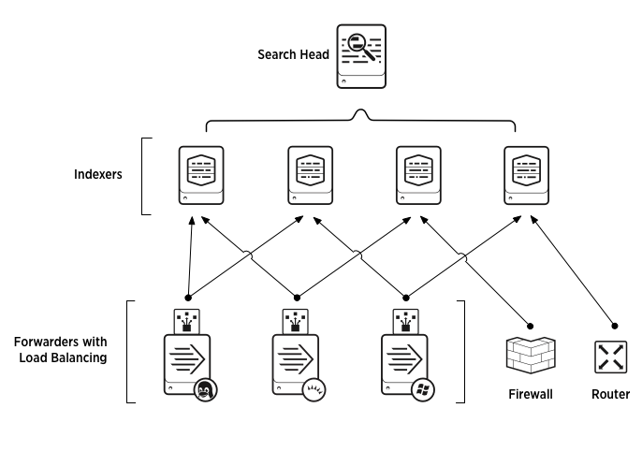
Splunk Architecture

Slide 18
Let’s start Splunk’n

Slide 19

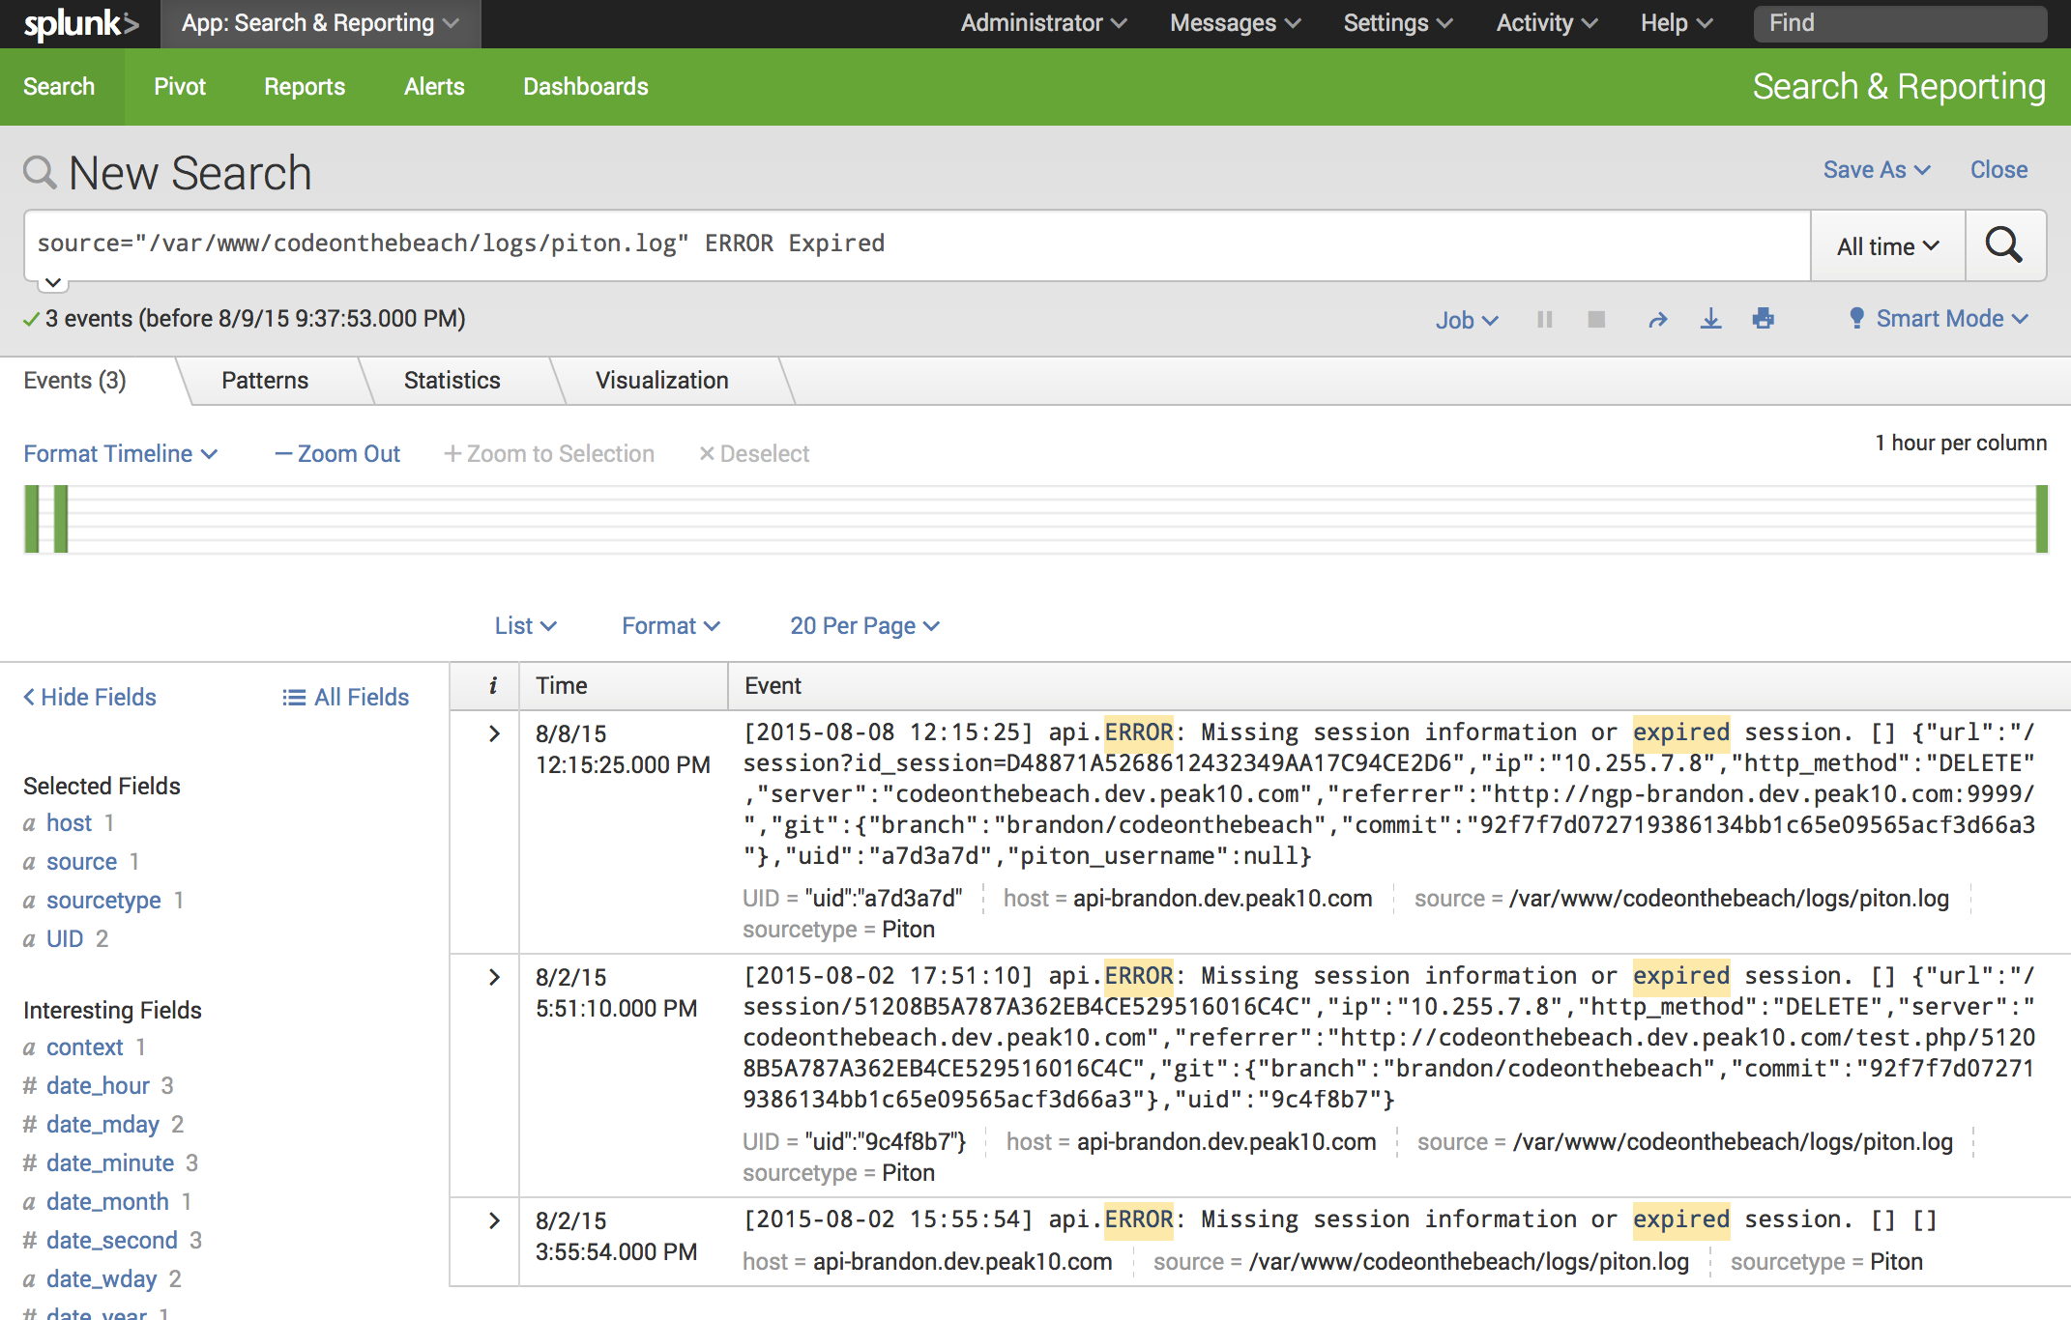
demo
Find errors easily
using full text search

Slide 20
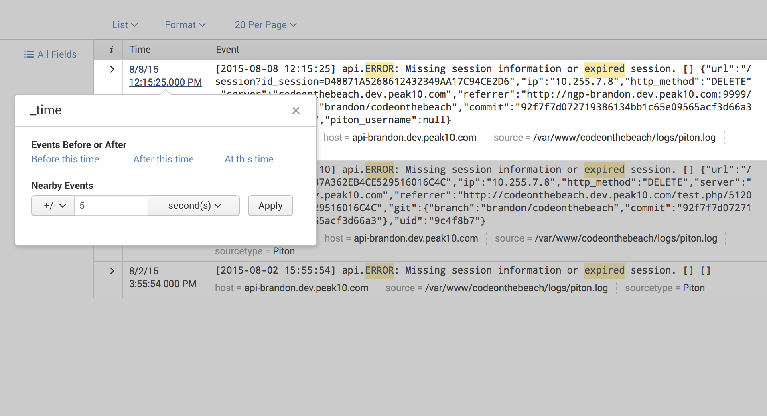
demo
Once you’ve found
the error, expand
the timeframe to find what else was happening at this time.

Slide 21
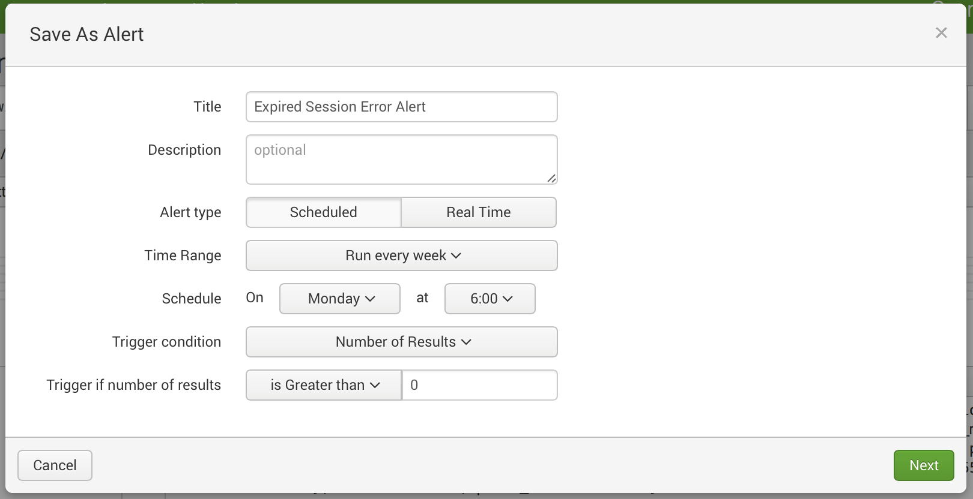
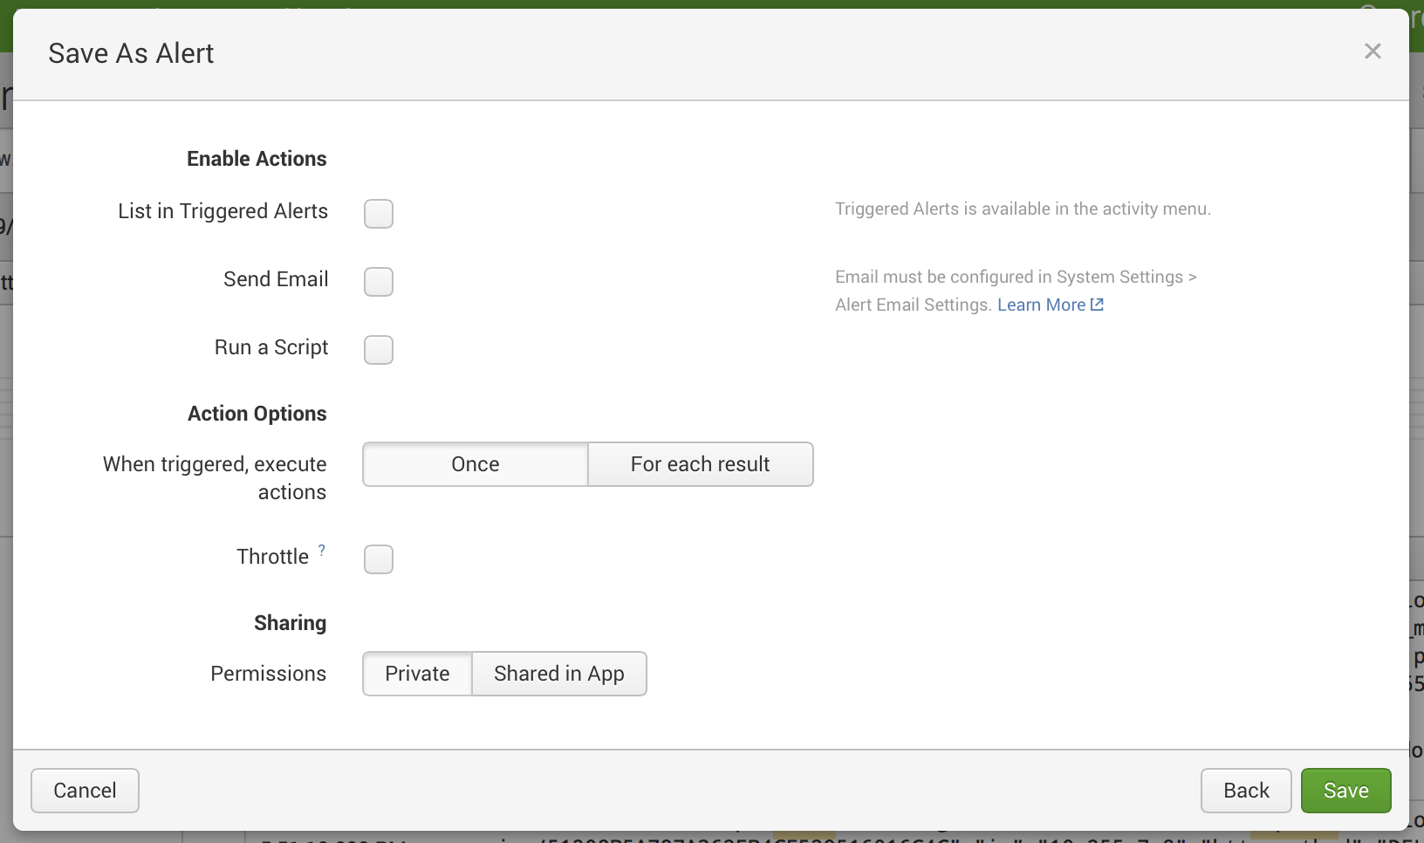
demo
Build alerts to notify you when the error happens again.

Slide 22
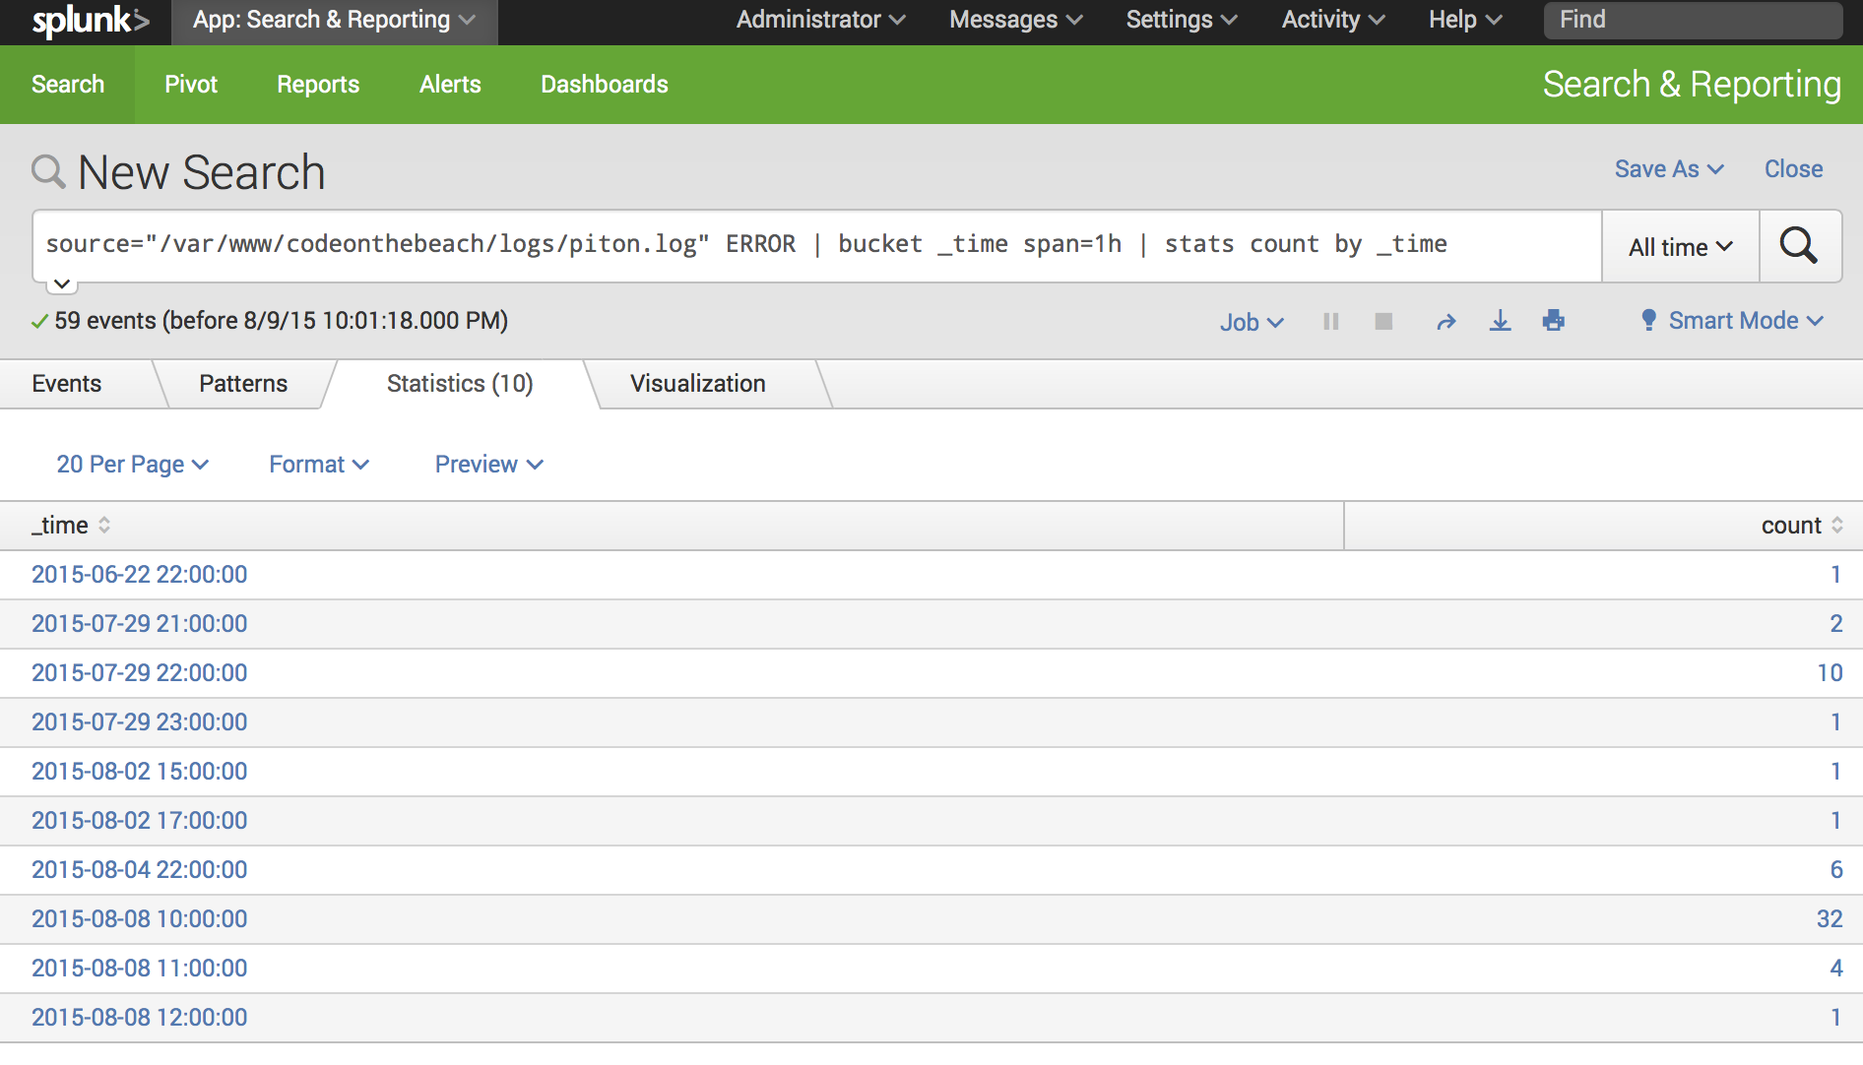
demo
Analyze data by piping results through advanced commands

Slide 23
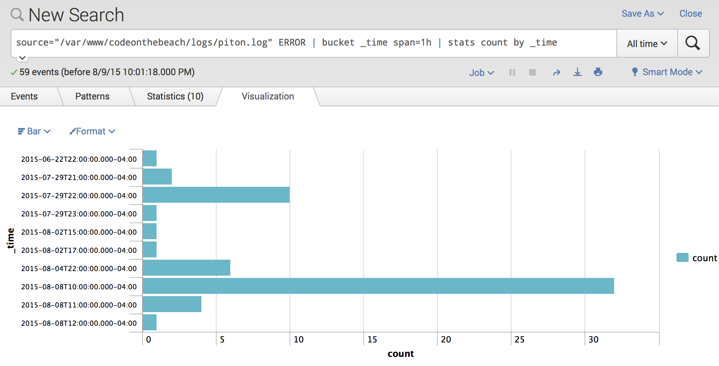
demo
In a single click, visualization your analysis

Slide 24
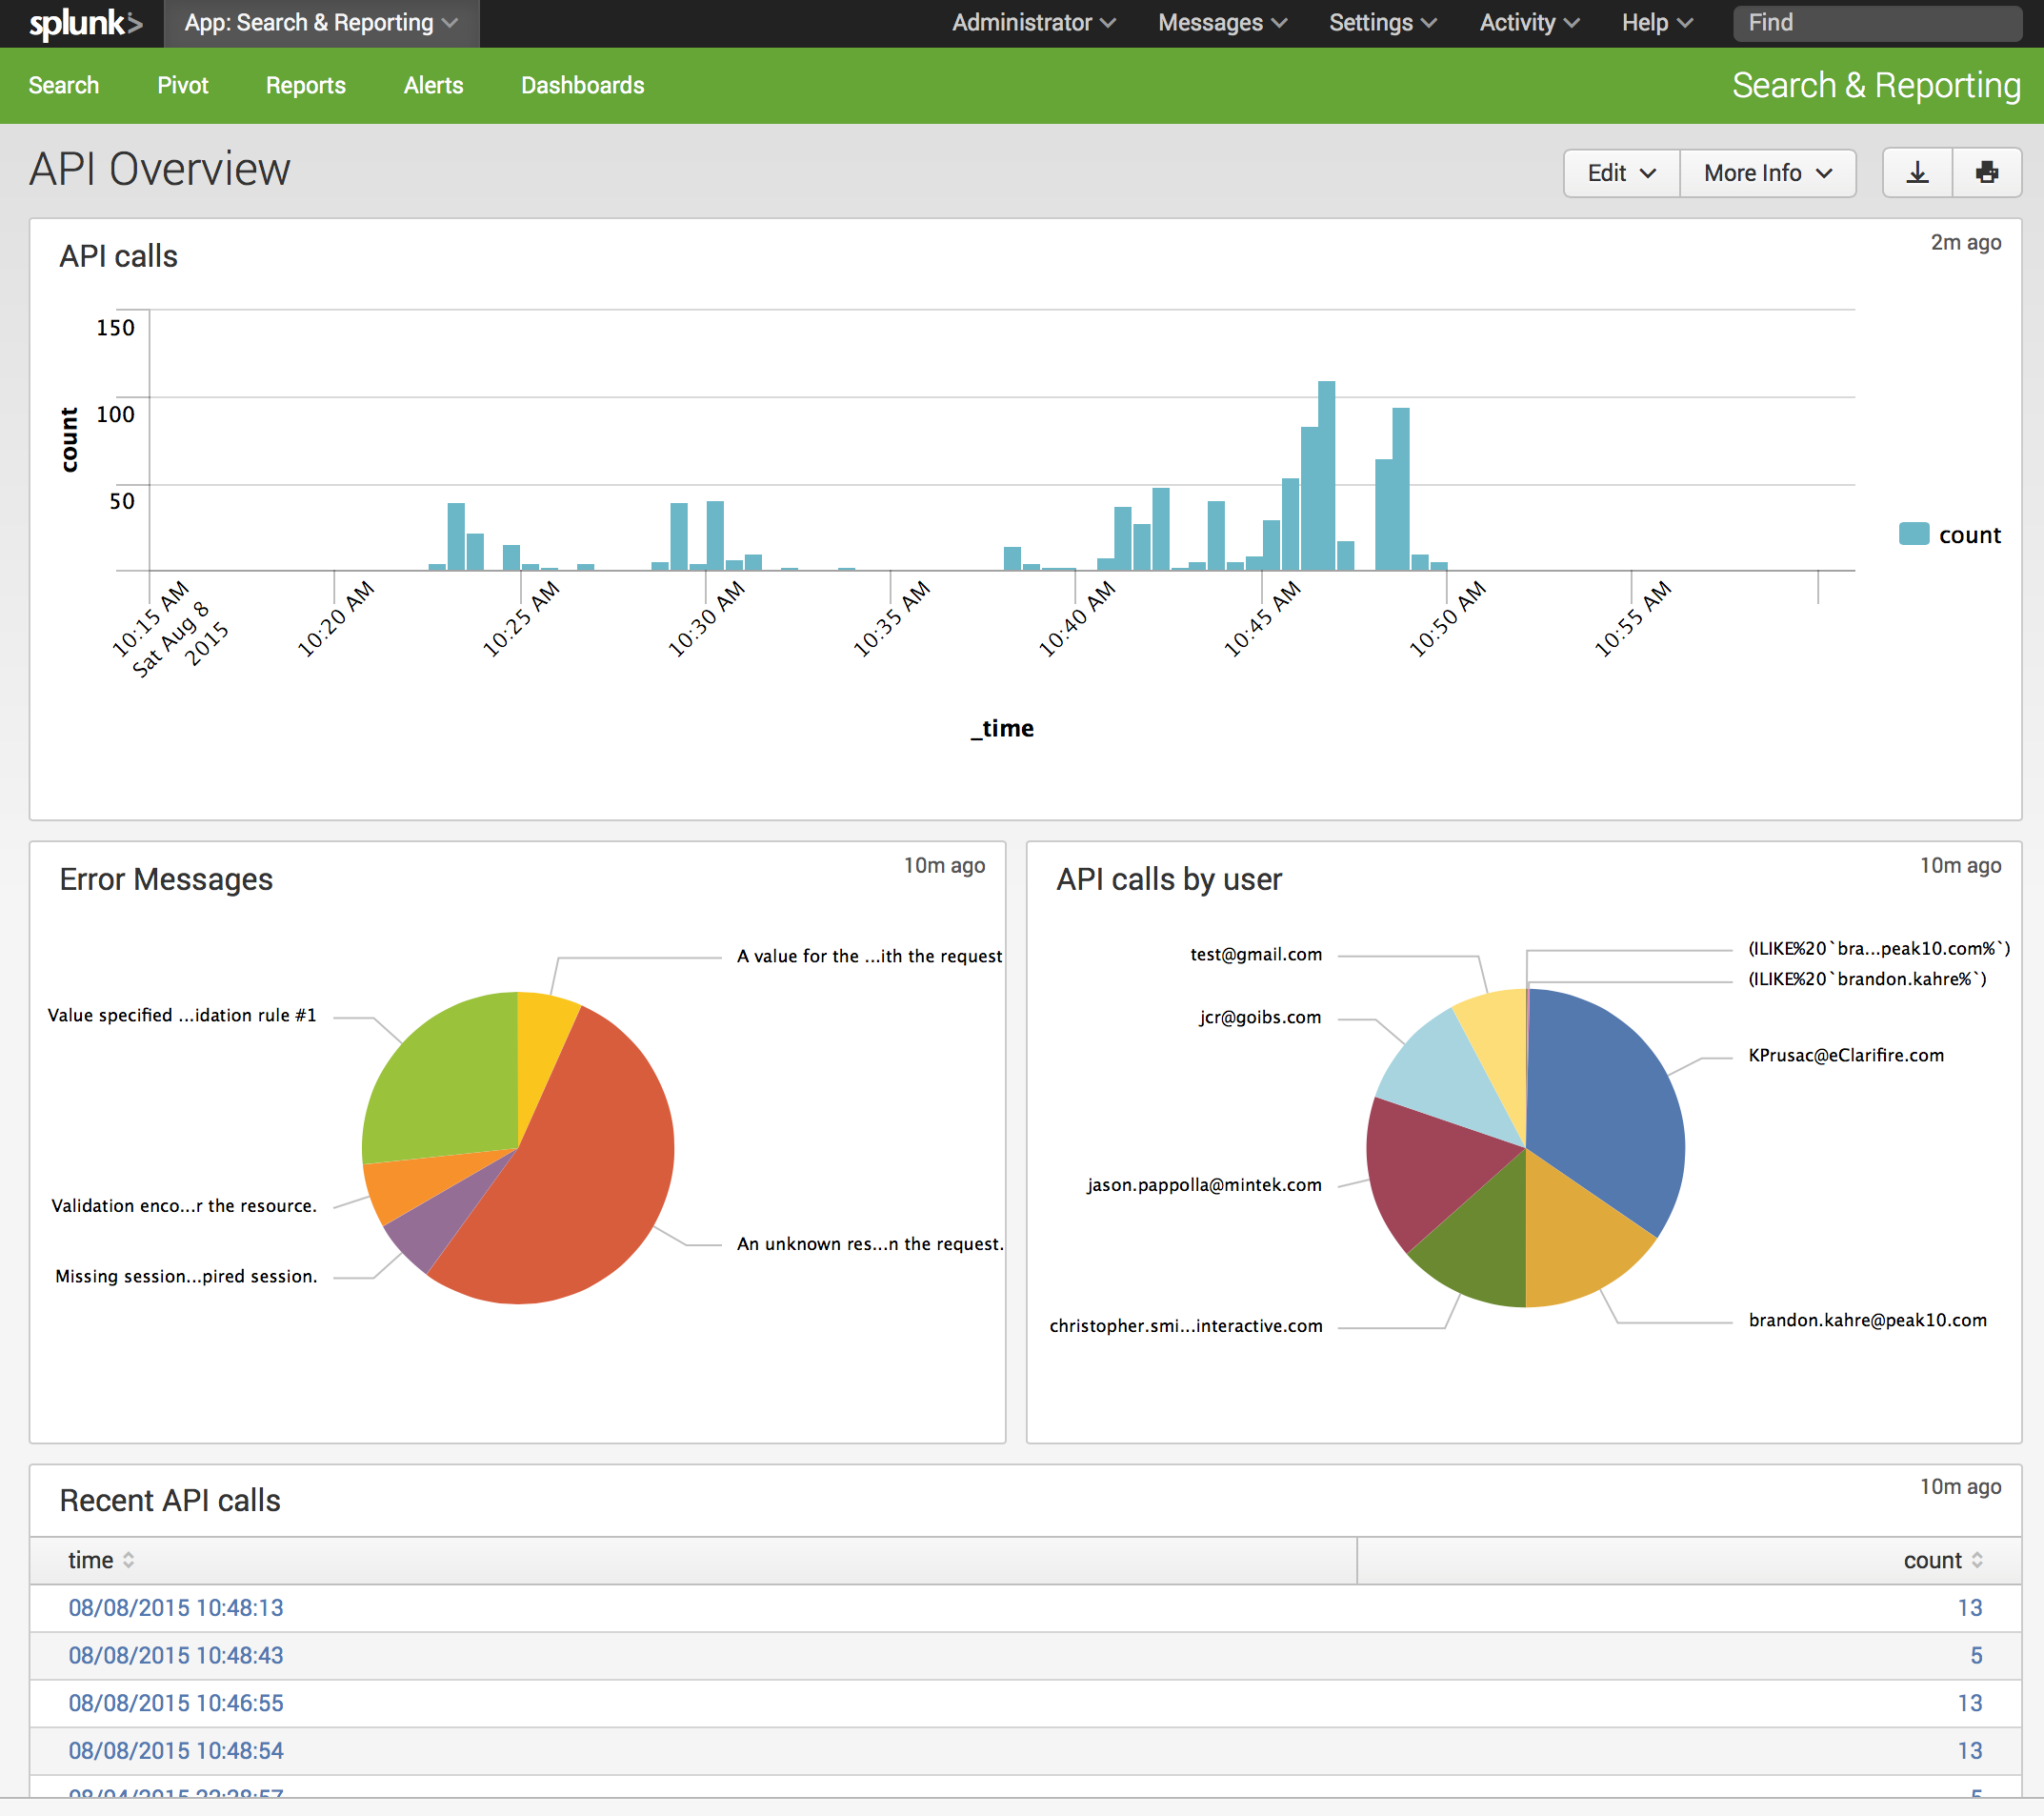
demo
Build dashboards to give you real-time intelligence

Slide 25

Questions?

Slide 26
Thank You!
Code on the Beach

